Slide 1
Introduction to DotNetNuke
Ian Robinson
Notes:
Time on Slide: 1:00
DotNetNuke is the most widely adopted platform for creating websites used on the Microsoft stack. We know this because of the following stats:
Have had over 6.5 million downloads since DotNetNuke was first released
Have more than 600,000 production websites in the world
We are averaging around 12,000 new DotNetNuke websites each month
We have about 10,000 extensions on Snowcovered.com – which is our official marketplace for commercial extensions that you can install into the platform
Our community is very strong, with over 800,000 registered community members on our website
Our community averages around 24,000 forum posts each month
In only 2 years, we have over 1,200 customers using Professional or Enterprise Edition
Microsoft has a piece of software that’s called the Web Platform Installer. It allows you to choose various web applications and install them on your computer or server. They track the number of times that an application is installed, and we have been number one in that list ever since the tool was released.

Slide 2
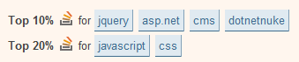
Meta / Resources
Session Feedback! http://www.stldodn.com
Twitter @irobinson
GitHub http://github.com/irobinson
StackOverflow Careers http://bit.ly/irobinson

Slide 3

DotNetNuke is the most widely adopted
Open Source platform for
building websites and web applications
On Microsoft technologies
Notes:
Time on Slide: 1:00
DotNetNuke is the most widely adopted platform for creating websites used on the Microsoft stack. We know this because of the following stats:
Have had over 6 million downloads since DotNetNuke was first released
Have more than 600,000 production websites in the world
We are averaging around 12,000 new DotNetNuke websites each month
We have over 8,000 extensions on Snowcovered.com – which is our official marketplace for commercial extensions that you can install into the platform
Our community is very strong, with over 800,000 registered community members on our website
Our community averages around 24,000 forums posts each month
In less than 2 years, we have nearly 1000 customers using Professional or Enterprise Edition
Microsoft has a piece of software that’s called the Web Platform Installer. It allows you to choose various web applications and install them on your computer or server. They track the number of times that an application is installed, and we have been number one in that list ever since the tool was released.

Slide 4



































Who’s using DotNetNuke?
Notes:
Time on Slide: 2:30
That’s all great, but who actually USES DotNetNuke? You may recognize many of the logos shown here. All of these organizations have vetted DotNetNuke, and chose it to be their platform of choice for one or more of their projects and websites. I would like to point out a few of these organizations to you though.
First, I would like to point your attention to NASA, the NSA or National Security Agency, and the United Nations. The reason that I want to tell you about them is simple. Security. These organizations have put DotNetNuke through its paces and found that it was secure enough to be used in their networks. This is especially important when you consider the NSA. They not only vet DotNetNuke to be installed into their network, but they also regularly perform security audits the software throughout their organization.
I would also like to point out the AFL on the upper-left side of the screen. If you don’t know who they are, they are the Australian Football League. They have one of the most highly trafficked DotNetNuke websites known. Each month, they have over 2.5 million unique visitors coming to their website. And at peak moments, they can have over 500,000 concurrent user sessions on their site. That’s over 500,000 people using their website at the same time!

Slide 5

Notes:
Time on Slide: 0:05
Let’s talk about the product itself now. When you consider DotNetNuke for any project, it offers you two solutions right out of the box.

Slide 6

Users can create content with little to no training
Notes:
Time on Slide: 0:30
First, it really does allow your end-users to very easily manage content with very little or no training at all. For example, many users will just need a login, and they will be able to manage content immediately.
(Give any of your own examples that you might have.)

Slide 7

Developers can rapidly build web applications
Notes:
Time on Slide: 1:00
The other solution that DotNetNuke provides, is for developers. Developers can now build web applications quicker than ever before. This is because they don’t have to “recreate the wheel” in their projects. All they have to worry about is their business logic. For example, if they’re building a new extension for DotNetNuke, they don’t need to worry about building things like login forms, security role management and so on. They further don’t have to worry about how a page is created, or how their application is going to be added to a page. They just need to worry about how their application will be interacted with by visitors on the website. Furthermore, you will soon see that they have a full API that they can leverage to save them time when programming.

Slide 8


Technology
DotNetNuke
.NET
Internet Information Server
Windows Server
ASP.NET
SQL Server
Notes:
Time on Slide: 1:30
When talking about DotNetNuke, it’s important to first talk about the technology that it runs on. DotNetNuke is an ASP.Net web application. As such, it must be installed and run on a Microsoft stack. For production websites, you would use Windows Server 2003 or 2008. DotNetNuke also requires IIS and the .Net framework to be installed. Right now, .Net framework version 3.5, service pack 1 (or higher) is required. DotNetNuke comes with support to run on SQL Server, but using its provider model, you can connect DotNetNuke to any database that you’d like. If want to use DotNetNuke for development, staging, QA, or something like that, you don’t need Windows Server. You can just as easily run DotNetNuke on Windows XP, Vista, or Windows 7. Also, while you can run DotNetNuke on SQL Server Express Edition, it is highly recommended that you use a full version for any mission critical website.

Slide 9


Architecture
Used by end-users to create dynamic and interactive websites
DotNetNuke
Web Content Management System
Web Application Framework
Used by developers to create application functionality
SQL Server
.NET
Internet Information Server
Windows Server
ASP.NET
Notes:
Time on Slide: 0:30
When you begin to dive deeper into DotNetNuke, you will begin to see that the two solutions that it provides are actually contained within the product itself. The web content management system is the part that the people will see when they visit your website, or the part that your content editors will see when updating content. The web application framework is the part of DotNetNuke that your developers will be programming against.

Slide 10




Web Content Management
Browser-based
administration;
unique content,
appearance
and membership
for each portal
Content
Pages
Users
Content
Pages
Users
Portal 1
Portal N
Multi-tenant
Portal Architecture
Modules
Skins
Skin Objects
Widgets
Language Packs
Extensions
Single DotNetNuke Installation
Websites, Domain Names, Users,
Security Roles, Content Editors, etc.
Notes:
Time on Slide: 3:00
Let’s continue with the web content management solution. DotNetNuke is built to be a multi-tenant solution. What that means to you is that you can host as many websites as you want from a single installation of DotNetNuke. Looking at the diagram here, you can see that your first site, or portal, will have its own pages, its own users, and its own content. Then, each additional website or portal that you add will also have its own content, pages, and users. Each portal is essentially in its own sandbox, so-to-speak. The users and administrators of each site wouldn’t even know that the other portals existed unless you told them.
What all of these portals will share though is something we call extensions. Extensions is a term in DotNetNuke, used to describe things that you can install into the platform. Extensions can be available to all sites that are on a single instance of DotNetNuke. These could include things such as:
Modules. Modules are mini-applications that you can install into DNN to perform a specific function. For example, modules can add functionality like Blogs, Forums, Surveys, CRMs, and more.
Skins. Skin (or skinning engine) is a word in DotNetNuke that describes the components that are used to change and define the design of the website. In other applications, they might call the same thing a “template”.
Skin Objects and Widgets are additional elements that you can add to skins.
Language Packs can be very important. DotNetNuke is a multi-lingual framework. It allows you to fully localize your site into any number of languages that you’d like. Language packs allow you to define static content in various languages, but you can also localize dynamic content as well.

Slide 11

Web Application Framework
Extensions
RADControls for ASP.NET AJAX
UI Components
User Controls, VB/C#, CSS, HTML, JQuery, etc.
Security, Syndication, Instrumentation, Localization …
Core Services
(API-enabled)
Data
Logging
Scheduling
Html Editor
Navigation
Search Index/Store
Permissions
Caching
Friendly URL
Roles
Profiles
Membership
Authentication
Plug-in Providers
Forms, OpenID, Active Directory, LiveID, Custom
Notes:
Time on Slide: 5:00
Now we’re going to talk about the web application framework side of DotNetNuke. This is where developers will spend most of their time.
Let’s begin with the blue boxes at the bottom. DotNetNuke has been built from the ground up to work on something called a “provider model.” What this means to you, is that there are several areas where you can very easily install and switch global functionality, without having to make changes to the entire website. For example, the default text editor that ships with DotNetNuke is the RadEditor by Telerik. If you wanted to replace this, you can simply install a new editor, change the name of the editor in the site configuration, and all of the modules and features that use the text editor will automatically begin using the new one.
Another great example of the provider module is our Authentication Providers. DotNetNuke ships with support for Web Forms, OpenID, LiveID, and Active Directory. However, if you wanted to also authenticate against a proprietary authentication source, such as LDAP, Twitter, or Facebook – you can. Just build, download, or buy a new authentication provider.
Moving up to the orange box. This is called the API, where developers would take advantage of existing functionality to integrate with DotNetNuke, and the providers it exposes. DotNetNuke developers wouldn’t necessarily care about what any of the providers are and which ones are installed. The way they use them would not change, regardless to who created the provider. So, your developers will not have to “recreate the wheel” when worrying about global functionality like Security, Syndication, or Localization. It’s built in and available to them.
Now, we can talk about the top area. This is the area where DotNetNuke developers would typically work, creating extensions. DotNetNuke extensions are nothing more than one or more user controls, with any supporting files that they need. The only exceptions are providers and skins. They are slightly different.
Your extensions can take advantage of any integration or ASP.Net functionality that you want. DotNetNuke does not place any limitations on you in this regard. If you want to use Silverlight, Flash, or jQuery – you can. In fact jQuery is built in to the platform. If you want to integrate with someone elses web services, REST, or database – you can.
DotNetNuke has the globally popular Telerik AJAX control suite integrated into the platform. This provides for a consistent, usable, and robust interface that you can use across all of your custom development. Telerik’s controls come with AJAX completely integrated, their look and feel can be easily changed, and they emit semantic and XHTML compliant code. As a customer, you would not only enjoy the integration of Telerik control suite like everyone else, but you’d also be able to have unlimited developer licenses for all of your developers, to build DotNetNuke solutions. If you have 8 developers, that’s a cost savings of $8,000, or more.

Slide 12





Portal
Pages
Users
Home
Contact
Products
Services
About
Pages
Users
Roles
Home
Contact
Products
Services
About
Roles
Single Portal
Pages
Users
Home
Contact
Products
Services
About
Pages
Users
Single Portal
Roles
Home
Contact
Products
Services
About
Pages
Users
Single Portal
Home
Contact
Products
Services
About
Pages
Users
Pages
Users
Home
Contact
Products
Services
About
Roles
Roles
Home
Contact
Products
Services
About
Roles
Single Portal
Roles
Single Portal
Single Portal
Pages
Users
Home
Contact
Products
Services
About
Single Portal
Roles
Pages
Users
Pages
Users
Home
Contact
Products
Services
About
Home
Contact
Products
Services
About
Single Portal
Roles
Roles
Single Portal
Single Portal
Notes:
Time on Slide: 0:30
Let’s talk about the portals in DotNetNuke again. Each portal can have it’s own users and security roles. It will also have it’s own pages with their own content, structure, and URLs. All of this, once again, separate from any other site that might be in your instance of DotNetNuke.

Slide 13
Portal Pages
Home
Contact
Products
Services
SKINS
Control over appearance and layout using HTML, CSS, images
MODULES Pluggable “mini-apps” to extend functionality
Notes:
robust skinning engine that allows you to install a Skin Package that you can use to granularly define the look and feel of your entire site. Other platforms might call this a theme, or a template.
When designing a skin, designers can use any of the technologies or tools that they are comfortable with. They can use any graphic design tools that they’d like to create the images. Then, they can use any HTML editor that they’d like for creating the HTML layout of the various pages in the site – such as Dreamweaver, Expression Web, Visual Studio, or even Notepad. DotNetNuke doesn’t place any limitations on the designer here. In fact, designers can use anything that they’d like in the actual design of the site, such as XHTML, CSS, images, jQuery, Silverlight, or Flash. The only thing that the DotNetNuke skinning engine actually requires of a designer is that they specify at least one content region on the page.
A content region in DotNetNuke is something we call a “Content Pane”. Designers must define at least one content pane on the page, as this will define where on the page that a content administrator can place modules on the page. In the diagram here, you can see that the designer created 3 different content panes in this layout.
To summarize, you de

Slide 14
Putting a Page Together
Notes:
Time on Slide: 1:00
Let’s get back to a page though. When your page is first added to a site, it might be plain or empty like you see here. So, the first thing that you want to do is install a skin.
{CLICK}
A skin will define everything about the page. It will determine the fonts, font colors and sizes, the background colors, images, the styling of the menu, and more. It also defines other elements on the page.
{CLICK}
Such as the placement of the logo, login links, and more.
{CLICK}
Finally, the skin package will also define not only where the modules are placed on the page, but how each of them can look as well. This is all controlled by your skin designer, not DotNetNuke.

Slide 15
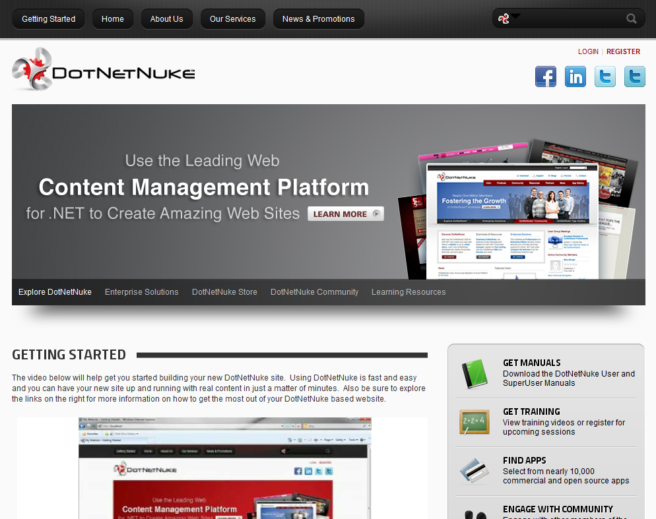
Notes:
Time on Slide: 0:05
While DotNetNuke looks like this when it is first installed…

Slide 16
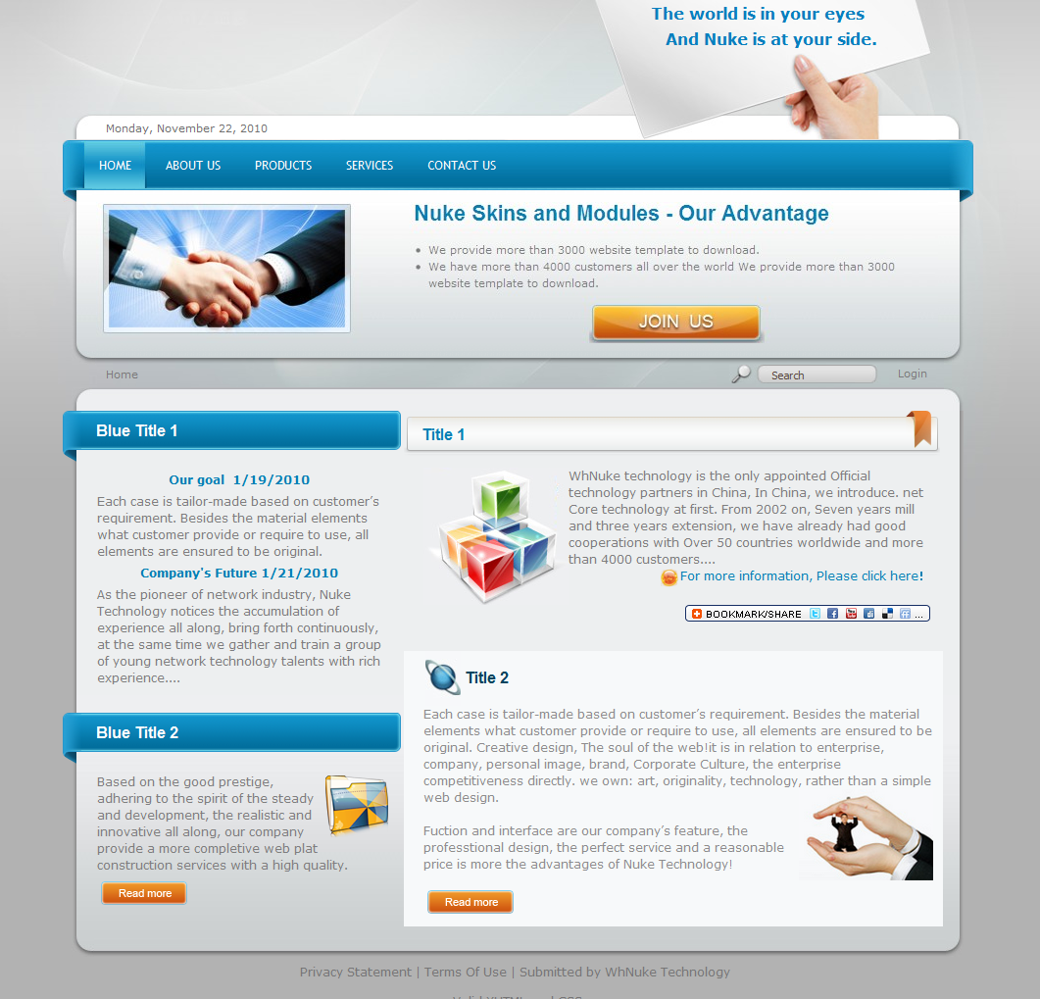
Notes:
Time on Slide: 0:05
Your site design could look business-oriented, like this.

Slide 17
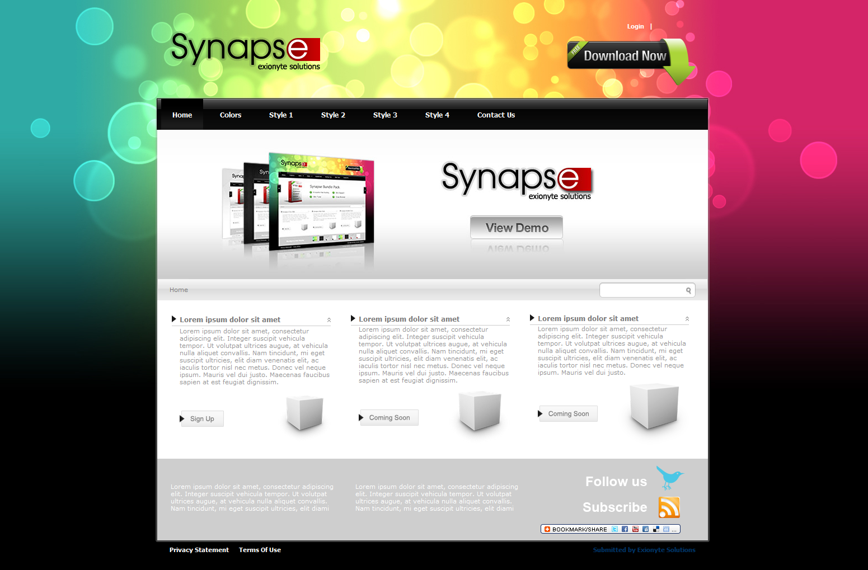
Notes:
Time on Slide: 0:05
Or it can look more colorful and vibrant, like this.

Slide 18
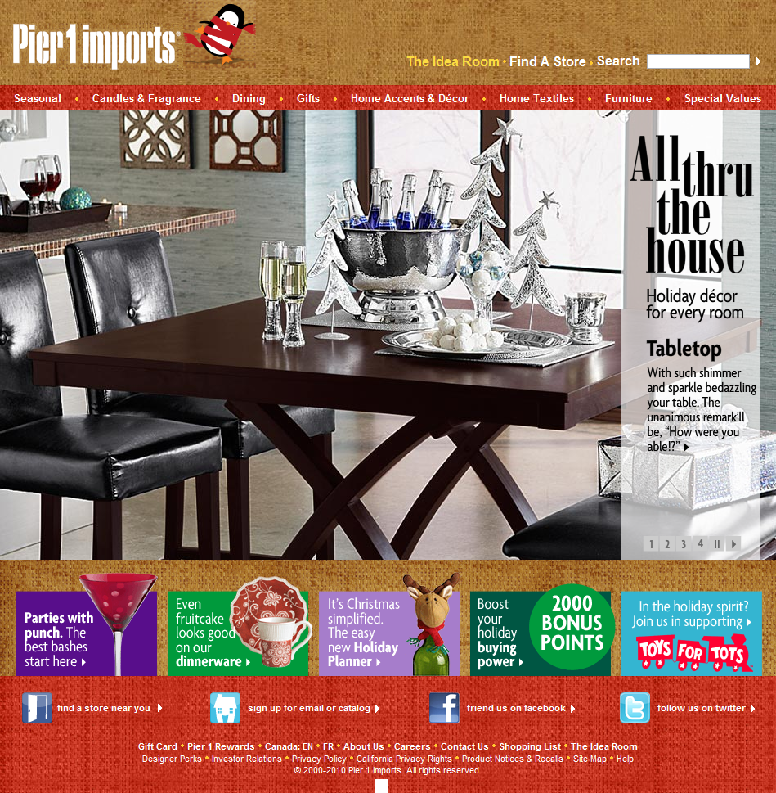
Notes:
Time on Slide: 0:10
This is an e-commerce website for the retail company, Pier 1 Imports. Pier 1 Imports is a publically traded company, with over 15,000 employees, and 1,000 retail locations in 49 states, Canada, and Mexico.

Slide 19
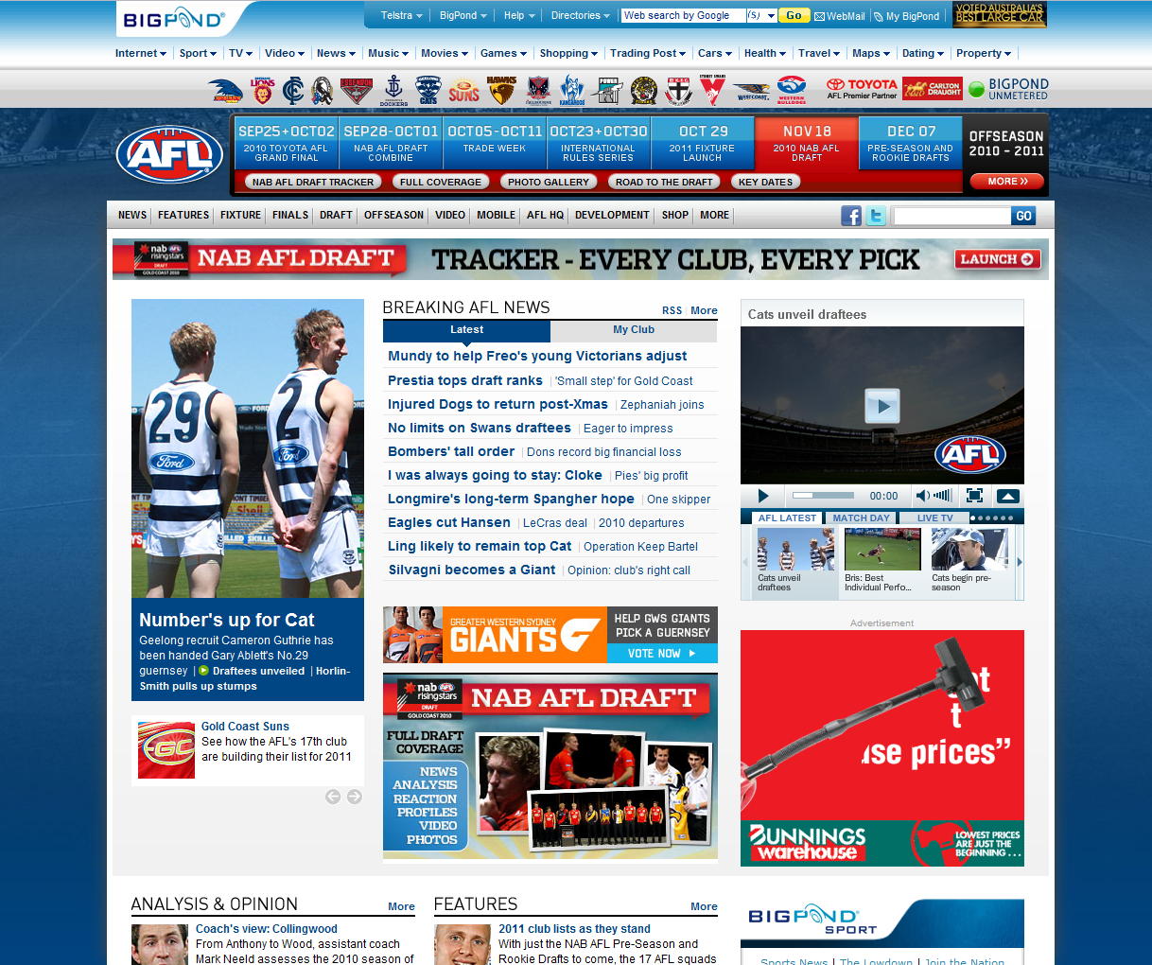
Notes:
Time on Slide: 0:10
This is the website for the Australian Football League that I mentioned earlier. They are not only using DotNetNuke, but they use media on their website extensively.

Slide 20
Users
SUPERUSERS
Access to all available capabilities including installing extensions, creating portals etc.
ADMINISTRATORS
Administration capabilities within the portal where her/his account exists
USERS
Delegated permissions by Administrators
Notes:
Time on Slide: 2:00
There are 3 classes of “users” in DotNetNuke. First, are the super users or host users. A host user defines what DotNetNuke can do. These users are able to go anything that they want on a single instance of DotNetNuke. No matter how many portals you have, they are able to manage each of them – but that’s not their primary responsibility. While they can edit content, a host user has two primary duties: installing extensions or functionality into DotNetNuke, and creating new websites. You can have as many host users as you want. However, best practices would suggest that you have as few as possible on your site.
The next class is Administrators. They define what a website can do. Unlike the host user, administrators can only manage things within their own website. They can manage content, users, security, pages, and more. They do all this without affecting the content, users, or security of any other site that you might have in your DotNetNuke instance.
Finally, there are “users” in DotNetNuke. Users can only do what an Administrator says that they can or cannot do. The administrators tell users what they can see or not see, and what they can edit or not edit. In fact, there may be times where a user isn’t able to see anything on a website.

Slide 21
Users
Host
Portal 1
Admin(s)
Portal N
Admin(s)
Roles
Roles
Users
Users
Notes:
Time on Slide: 1:00
Let’s step through the hierarchy of users. First, we begin with the Host or “Super” user. You can have as many as you’d like.
{CLICK}
Next, you will have one or more Administrators on the original website. You can have as many as you’d like.
{CLICK}
Your administrators would then define the security roles that your site needs in order to properly manage users and content. You can define as many security roles as you want.
{CLICK}
Next, you can assign one or security roles to various users on your site. You can have users in multiple roles if you’d like, and some might not even need to be in any roles at all.
{CLICK}
As you add new websites, you would just repeat the needed steps from the administrators down. Each site would have its own security roles defined, its own users, and
{CLICK}
they wouldn’t have any affect on the other sites that are already in your instance of DotNetNuke. In fact, they wouldn’t even know that the other sites existed unless you told them.

Slide 22
Demonstration
Let’s see this in action!
Notes:
PRESENTER NOTES:
Move from your slide show to your demo website. Begin the demo. Once you conclude the demo, return to the slide show and proceed with the next slide.

Slide 23
Benefits: End-Users
Easy to Edit Content
Control Access
Ensure High Quality Content
Easy to Manage Content
Notes:
Time on Slide: 0:20
If you’re an end-user that can simply view, or manage the content, DotNetNuke offers you some direct benefits to make your life easier.
Easy to Edit Content – Content editors often need little or no training to get started managing their own DotNetNuke site. It’s easy to work with the site – even if you’re simply a website visitor.
Control Access – It is very easy for content editors to control access to the content and features throughout DotNetNuke with granular permissions.
Ensure High Quality Content – Through tools like the HTML Editor, Workflow, and Content Staging, it’s easier than ever before to ensure that the quality of the content being added to your site meets or exceeds your expectations.

Slide 24
Benefits: Web Developers & Designers
Easy to Extend
Integrated Features
Open API
Reduce Time to Complete Projects
Notes:
Time on Slide: 0:30
Web developers and web designers have an abundance of flexibility and work done for them. Whether they take advantage of existing features, or leverage the framework to save time, projects can get done faster, with better results. This is primarily because you only have to worry about your business logic, and the way your skin or extension looks.
Easy to Extend – There are over 10,000 extensions in the Snowcovered Marketplace, and more in the Forge. It is very easy to install existing extensions to enhance, add to, or replace existing functionality.
Open API – The API has a vast amount of functionality that you don’t have to recreate. You just worry about your business logic. The API allows you to very easily build complex functionality on top of DNN, and allow other applications to plug-in to DNN.
Integrated Features – There are numerous features that you can re-use in your own development and designs, including: user controls, telerik controls, skin widgets, and more.

Slide 25
Benefits: Business Managers
Ease of Use
Ease to Extend
Multi-Tenancy
Quality / Security
Low Upfront Cost & High ROI
Notes:
Time on Slide: 0:30
As a decision-maker, one of the most important things that you need to be concerned of with every project is return on investment, or ROI. DotNetNuke has a very well-earned reputation for having the highest ROI in comparison to any other solution that offers similar features. This is mainly due to…
Ease of Use – It is very easy to begin using DNN to manage content and create new sites.
Ease to Extend – If there is existing functionality that you need in the DNN ecosystem, you can have it installed and use it in just a couple of minutes. If you are building custom functionality, the time it takes to build it can done as much as 60% faster.
Multi-Tenancy – When you need to roll out a new website, you can do that from within the existing website – saving you time and money.
Quality / Security – It is very easy to ensure that the content published on your site is of the highest quality, and you have the highest level of security available to DNN websites.

Slide 26

Benefits: Summary
End Users
Designers & Developers
Business Managers
Notes:
It doesn’t matter if you’re an end-user, a designer or developer, or a business manager. DotNetNuke is flexible enough to meet the needs of your organization.

Slide 27
DotNetNuke Editions
Community Edition
Paid, commercial solution
Optimized for business-critical applications
Free, Open Source solution
Deployed in hundreds of thousands of production websites
Professional Edition
Technical support online via DotNetNuke.com Forums
Online support from DotNetNuke Corp.
Enterprise Edition
Paid, commercial solution
For large, business-critical websites
Content Staging SharePoint Connector
Online Support from DotNetNuke Corp.
Notes:
Time on Slide: 1:00
There are currently 3 editions of DotNetNuke. First, we have the community edition, or CE. Community edition is the base core framework for all editions of DotNetNuke. It’s freely available for you to download and use, and it has been vetted in hundreds of thousands of websites world-wide. However, if you need support or any mission-critical features, then this edition may not be for you. Support is only available through the community forums on the DotNetNuke website.
The other two editions are Professional and Enterprise Edition. They are both highly optimized and tested for mission-critical web applications and websites. They include additional functionality and features that are essential to maintain a higher level of security and performance. Each comes with unlimited e-mail-based support through the DotNetNuke Corporation ticket system. The main difference between the two editions is the content staging feature found in Enterprise Edition. This feature allows you to perform all of your content editing on a staging website, and then publish your content to your production website.

